Slide 1


Crash Course on GIT (Short Version)
Carlos Diego N. Damasceno - https://github.com/damascenodiego/

Slide 2


Crash Course on GIT
Scott Chacon and Ben Straub. 2014. Pro Git (2nd ed.). Apress, Berkely, CA, USA.
Eric Sink. 2011. Version Control by Example (1st ed.). PYOW Sports Marketing.

Slide 3



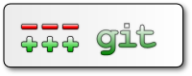
Agenda
Version Control
Version Control Systems (VCS)
Types of VCS
Crash Course on Git
git history
Basic concepts
Installing git
Getting started
GitHub 101
Eclipse Git
References++

Slide 4

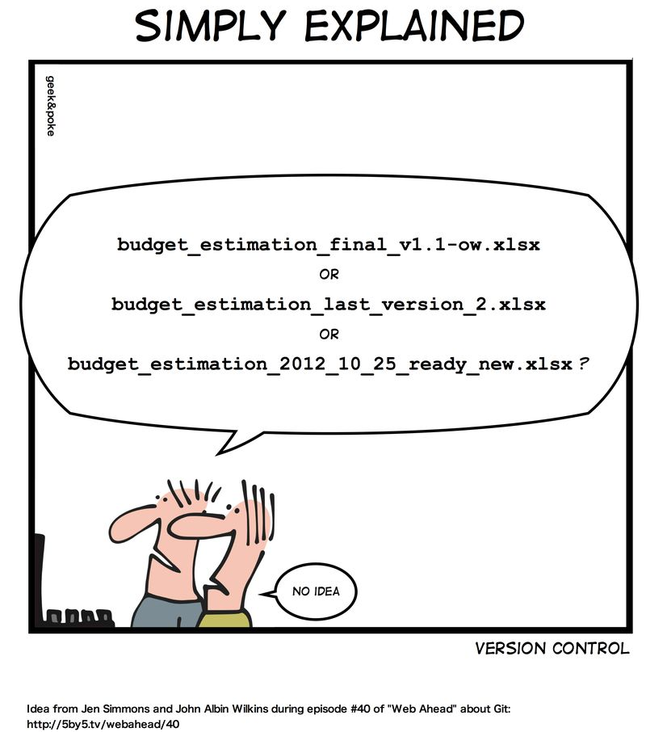

Slide 5



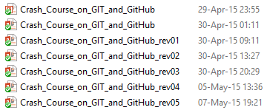
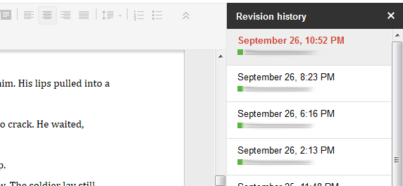
Version Control
Notes:
“The task of keeping a software system consisting of many versions and configurations well organized”
[Kemper & Oxley, 2012]
Kemper C., Oxley, I. 2012. Foundation Version Control for Web Developers. Appress.
“A software that helps developers on a software team to work together and also archives a complete history of their work.”
[Sink, 2011]
Eric Sink. 2011. Version Control by Example (1st ed.). PYOW Sports Marketing.

Slide 6
Version Control
Software Configuration Management (SCM)
Umbrella activity [Pressman, 2010]
“The art of identifying, organizing, and controlling modifications to software being developed”
Maximize productivity by minimizing mistakes → Confusion!!!
Tasks
Identification
Version control
Change Control
Configuration auditing
Reporting
Pressman, R. S. Software engineering: A practitioner’s approach. 5th ed. McGraw-Hill Higher Education, 2001.

Slide 7
Version Control System
“A software that helps developers on a software team to work together and also archives a complete history of their work.”
[Sink, 2011]
Eric Sink. 2011. Version Control by Example (1st ed.). PYOW Sports Marketing.

Slide 8

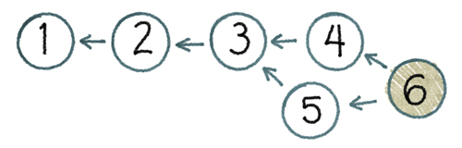
Version Control System
Three basic goals of a Version Control System (VCS) [Sink, 2011]
People must be able to work simultaneously, not serially.
No conflicting changes
Keep every version of everything that has ever existed
Eric Sink. 2011. Version Control by Example (1st ed.). PYOW Sports Marketing.

Slide 9
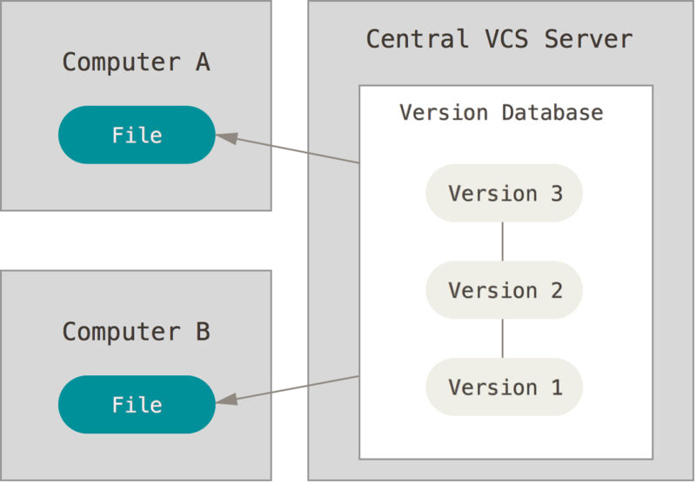
Types of Version Control Systems
Centralized VCS (CVCS)
Central Server
Collaborative work
Single point of failure
Examples
Concurrent Version System (CVS)
http://www.nongnu.org/cvs
Apache Subversion (SVN)
https://subversion.apache.org
Most popular CVCS
Centralized version control [Chacon & Straub, 2014]
Scott Chacon and Ben Straub. 2014. Pro Git (2nd ed.). Apress, Berkely, CA, USA.

Slide 10
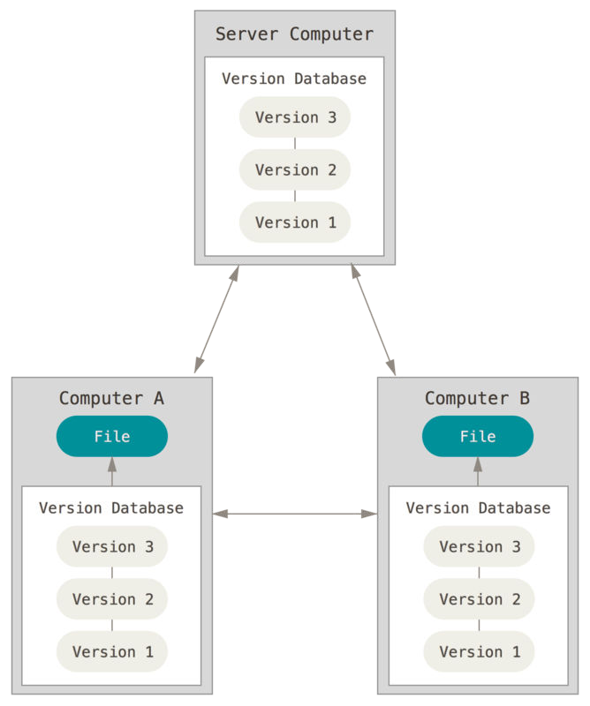
Types of Version Control Systems
Distributed VCS (DVCS)
Remote Server
Collaborative work
Several remote servers
Full backup
Examples
Mercurial (hg)
http://mercurial.selenic.com/
git
http://git-scm.com/
https://github.com/
Distributed version control [Chacon & Straub, 2014]
Scott Chacon and Ben Straub. 2014. Pro Git (2nd ed.). Apress, Berkely, CA, USA.

Slide 11


Slide 12



Crash Course (git history)
Linux kernel
Linus Torvalds
Open source software project of fairly large scope
1991–2002: Changes passed around as patches/archived files
2002: Proprietary DVCS → BitKeeper
2005: Linux community and the BitKeeper company relationship broke down
Free-of-charge status was revoked

Slide 13


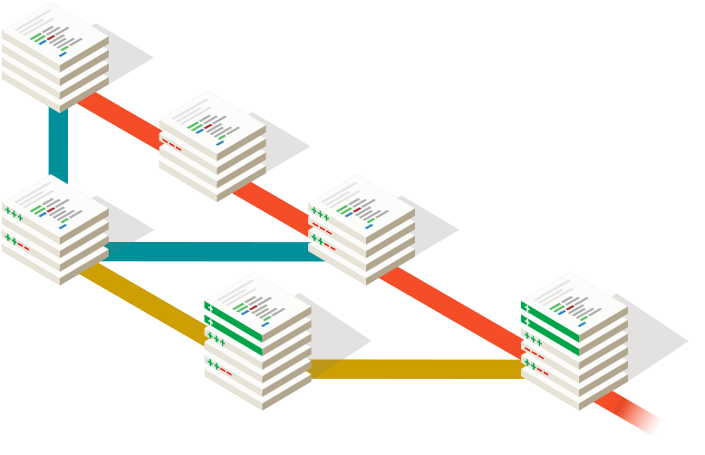

Crash Course (git history)
VCS requirements
Speed
Simple design
Strong support for non-linear development
Thousands of parallel branches
Fully distributed
Able to handle large projects efficiently
e.g. Linux kernel

Slide 14

Crash Course (git history)

Slide 15
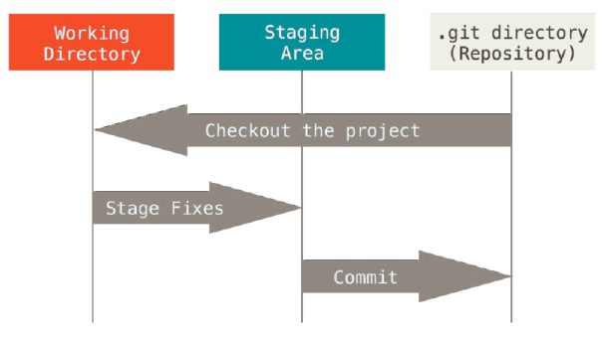

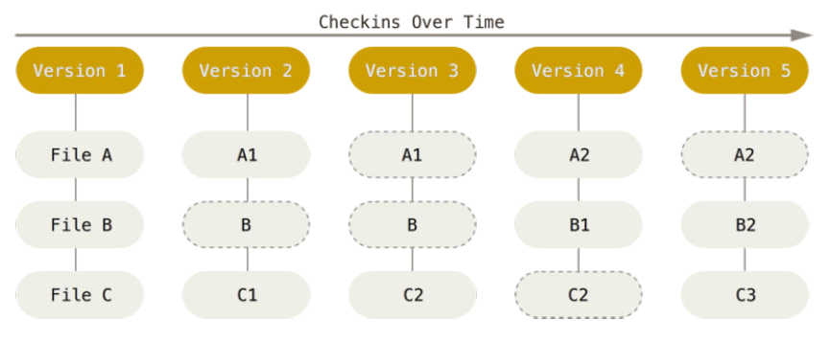
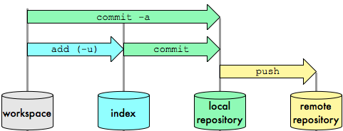
Crash Course (Basic concepts)
Basic concepts
Snapshots
Integrity
Generally only adds data
The three states
Storing data as snapshots of the project over time.
24b9da6552252987aa493b52f8696cd6d3b00373
The three stages: Working directory, staging area, and Git directory.
Notes:
Snapshot:
the way git keep versions.
Each snapshot contains all the files versioned.
New files are inserted and not edited files reference the last commit (saves space)
Integrity:
Creates a hash for each commit/file.
Enable integrity checking
Generally only adds data
Often you will only save stuff in your rep (commit)
You can also delete info from there, however it is not common.
Of course you can also grab older commits (pull/fetch/chechout)
3 states
Work dir: where you edit
Stage area: intermediate step before commit/rep
.git dir (rep): where the versions are locally kept

Slide 16





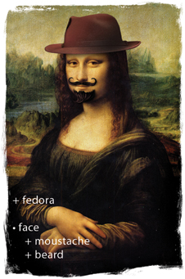

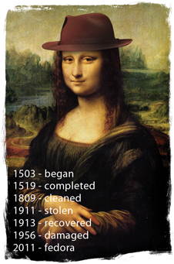
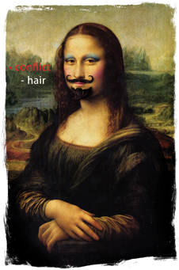
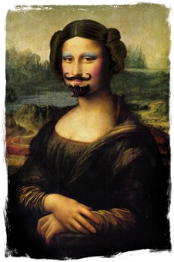

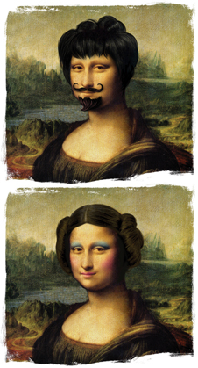
Crash Course (Basic concepts)
Basic operations
Add
Edit
Delete
Rename
Status
Diff
Revert
Log
Tag
Branch
Merge
Resolve
Eric Sink. 2011. Version Control by Example (1st ed.). PYOW Sports Marketing.
Notes:
Branch!!!!!!
A---B---C topic
/
H---I---D---E---F---G master

Slide 17

Crash Course (Installing git)
Windows - http://git-scm.com/download
Linux - Package management tool
# ~ apt-get install git
Notes:
Access http://git-scm.com/download

Slide 18
Crash Course on GIT (Short Version)
Getting Started
Notes:
Create a directory named ”gitcourse” → mkdir gitcourse
Change for this directory → cd gitcourse

Slide 19
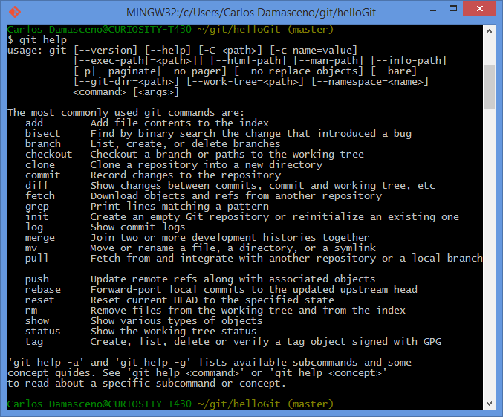
Crash Course (Getting Started)
git help
git help <parameter>
Notes:
git help
It shows the git manual.

Slide 20
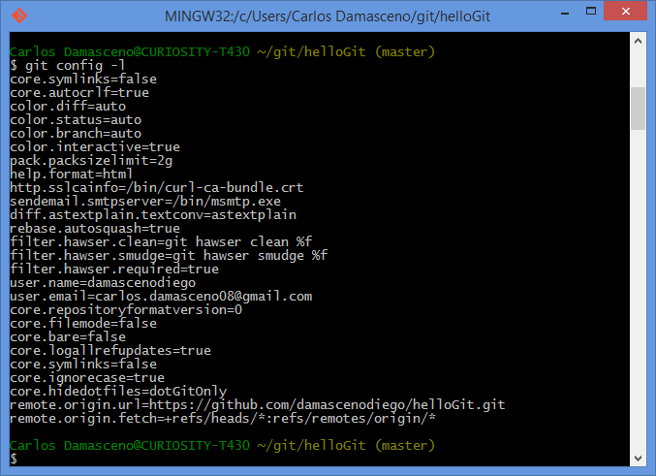
Crash Course (Getting Started)
git config -l
git config --global <variable> <parameter>
Notes:
git config
This command allows to check and edit the settings of a specific project. E.g. username (user.name) and email (user.email).
IMPORTANT TO SET UP PARAMETERS!!! → “TELL ME WHO YOU ARE!!!!!!!”
git config -l
git config user.name
git config user.email
git config –global user.name
git config –global user.email

Slide 21
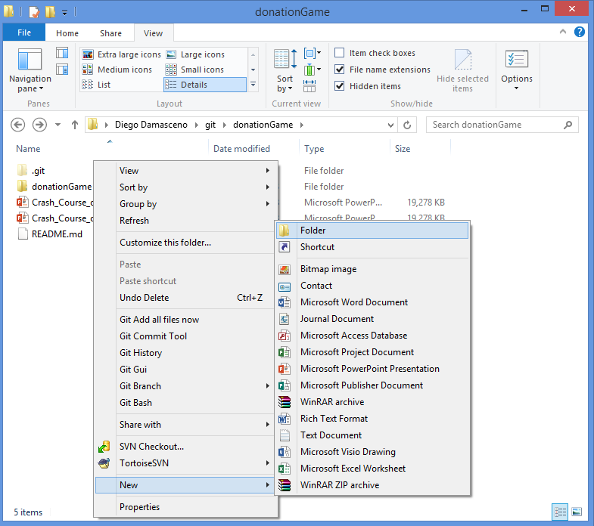
Crash Course (Getting Started)

Slide 22
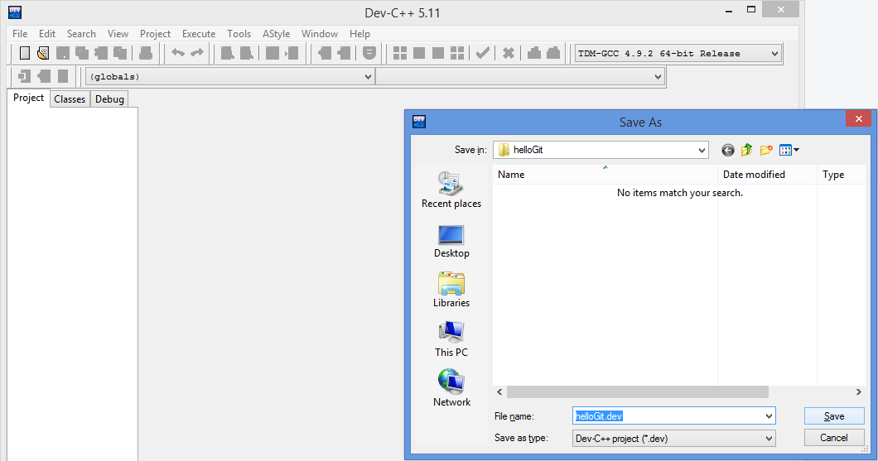
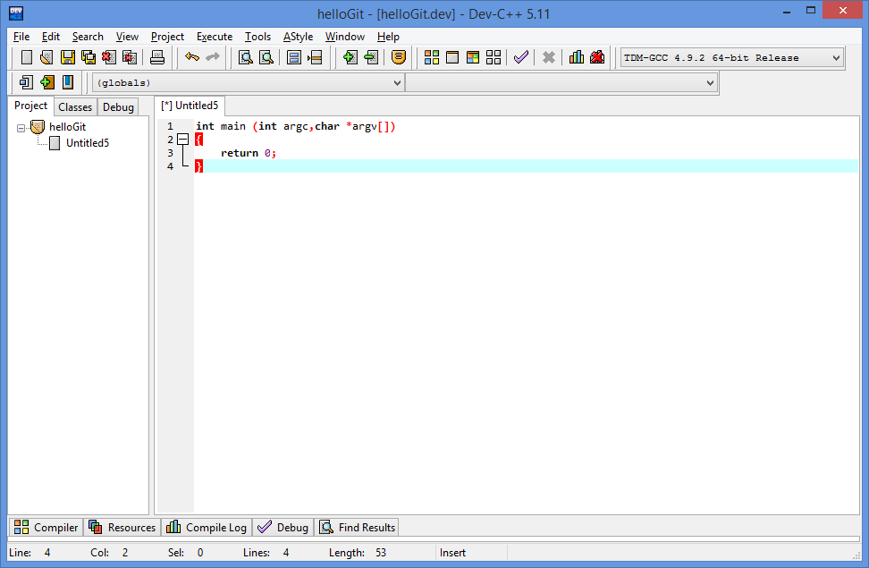
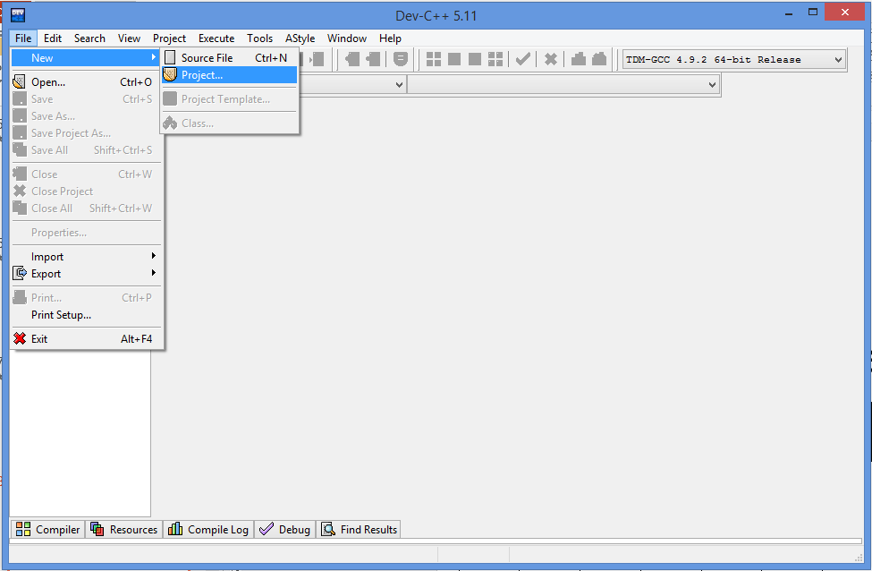
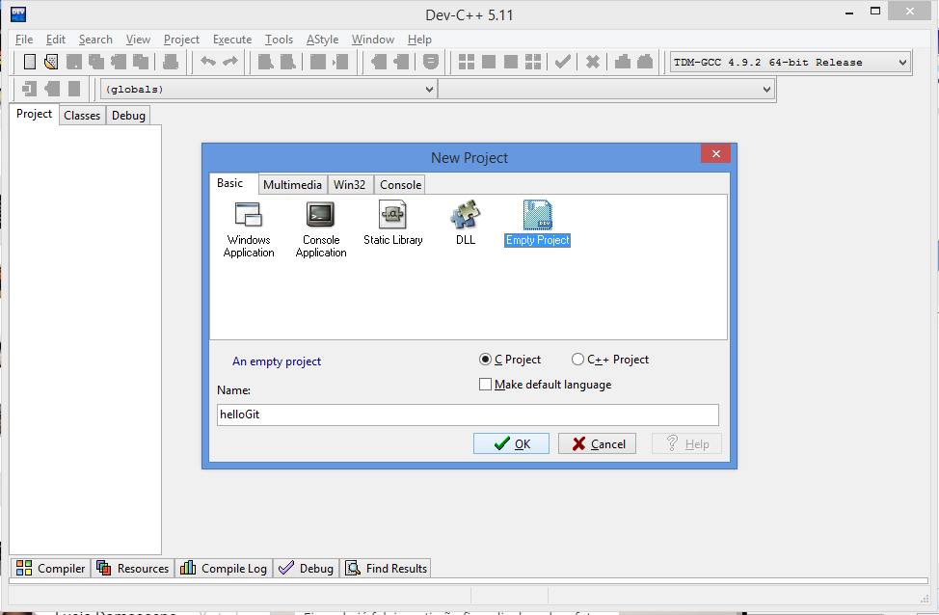
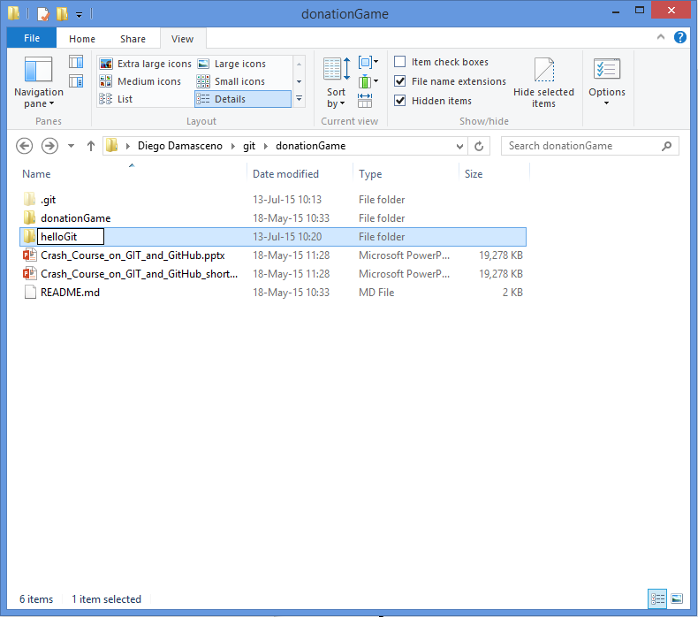
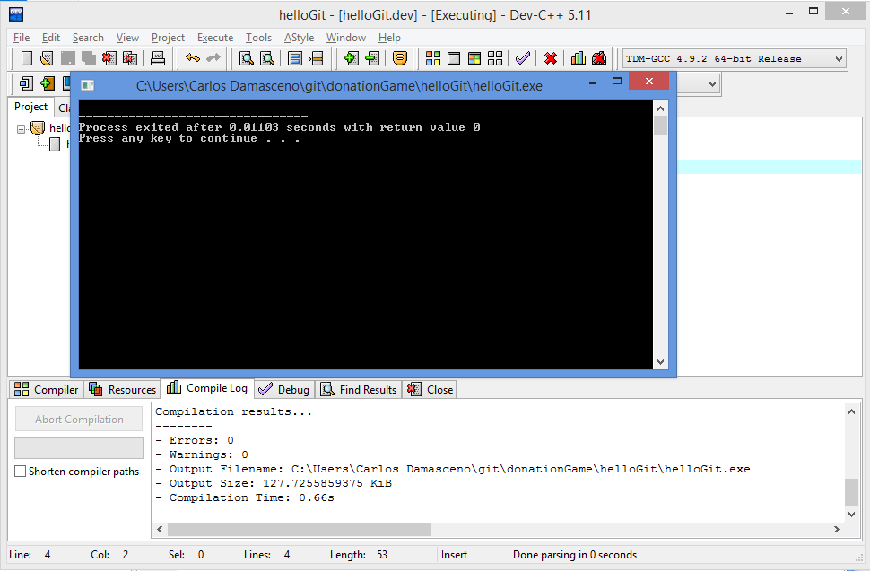
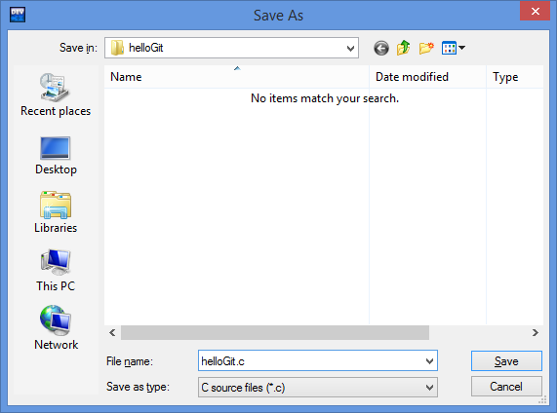
Crash Course (Getting Started)

Slide 23
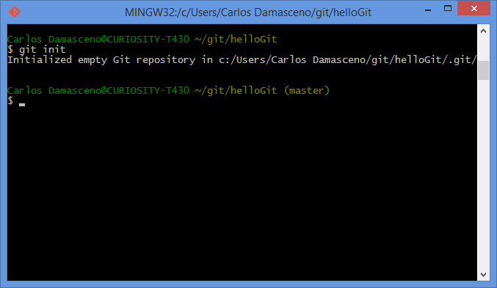
Crash Course (Getting Started)
git init
Notes:
git init
This command allows to setup a git repository. It creates the .git directory – a Git repository skeleton.
At this point nothing is tracked!

Slide 24
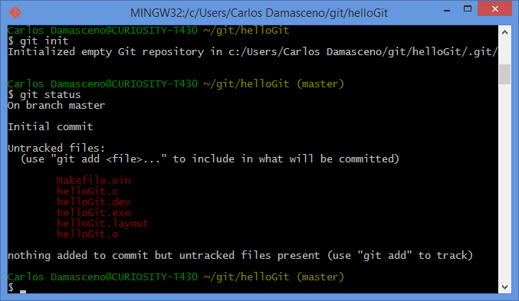
Crash Course (Getting Started)
git status
Notes:
git status
This command shows differences between working directory, staging area and last commit in the repository.

Slide 25
Crash Course (Getting Started)
The three stages: Working directory, staging area, and Git directory.
Notes:
working directory: where your files are located. You edit here
staging area: you keep/organize files before commit
commit
.git dir: files are versioned
Checkout: grab files from rep

Slide 26
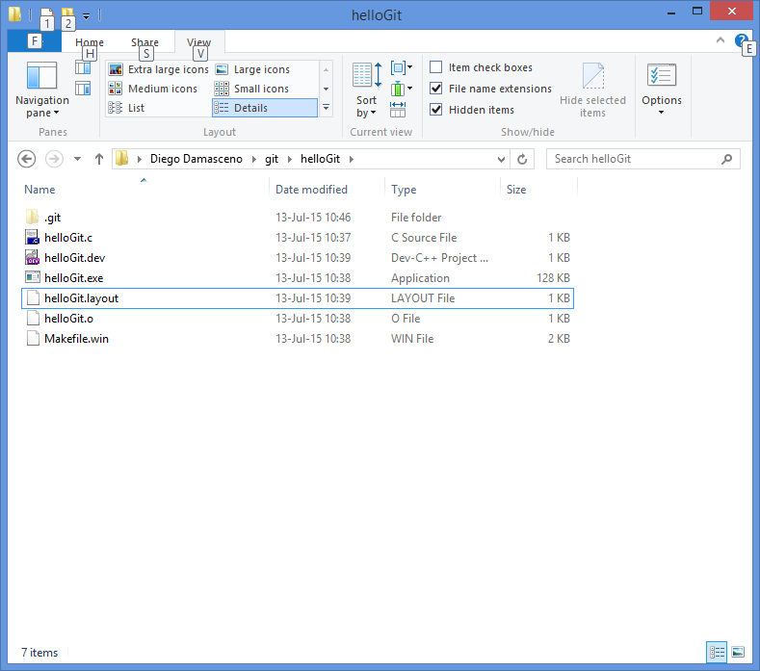
Crash Course (Getting Started)

Slide 27
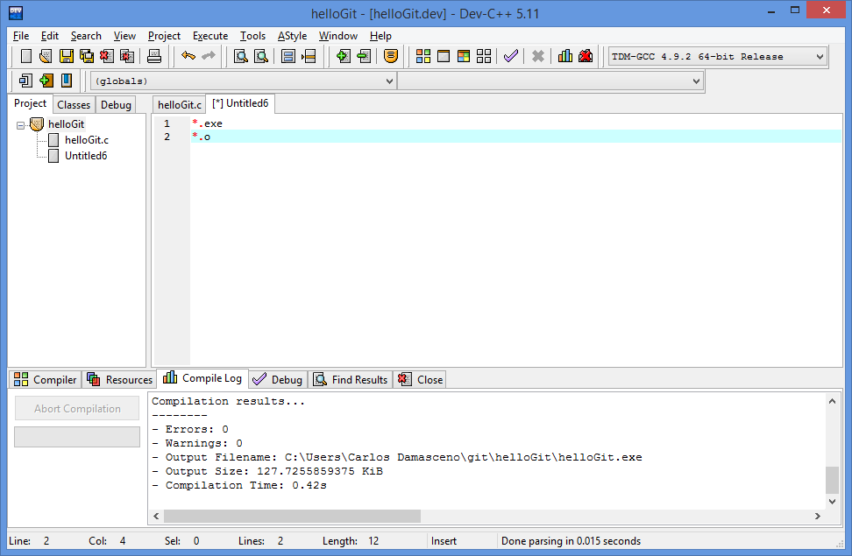
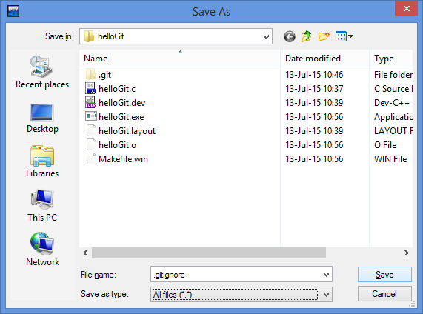
Crash Course (Getting Started)
Notes:
.gitignore

Slide 28
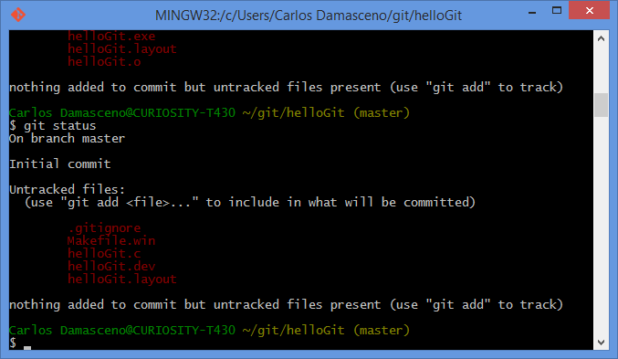
Crash Course (Getting Started)
Notes:
.gitignore

Slide 29
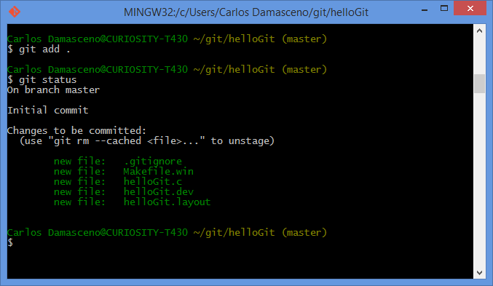
Crash Course (Getting Started)
git add <filenames>
git status
Notes:
git add
This command updates the index (staging area) using the current content found in the working tree (working directory), to prepare the content staged for the next commit.

Slide 30
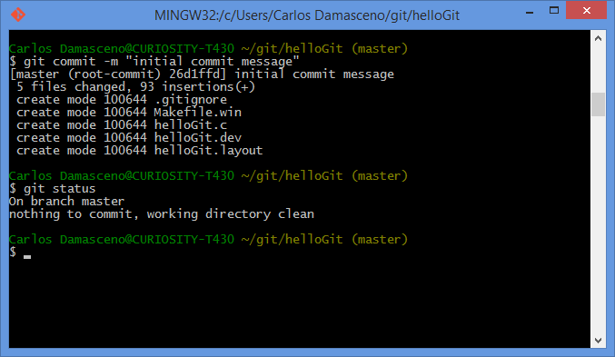
Crash Course (Getting Started)
git commit –m ‘<message>’
git status
Notes:
git commit
Stores the current contents of the index (staging area) in a new commit along with a log message from the user describing the changes.

Slide 31
Crash Course (Getting Started)
unversioned
git commit
git init

Slide 32
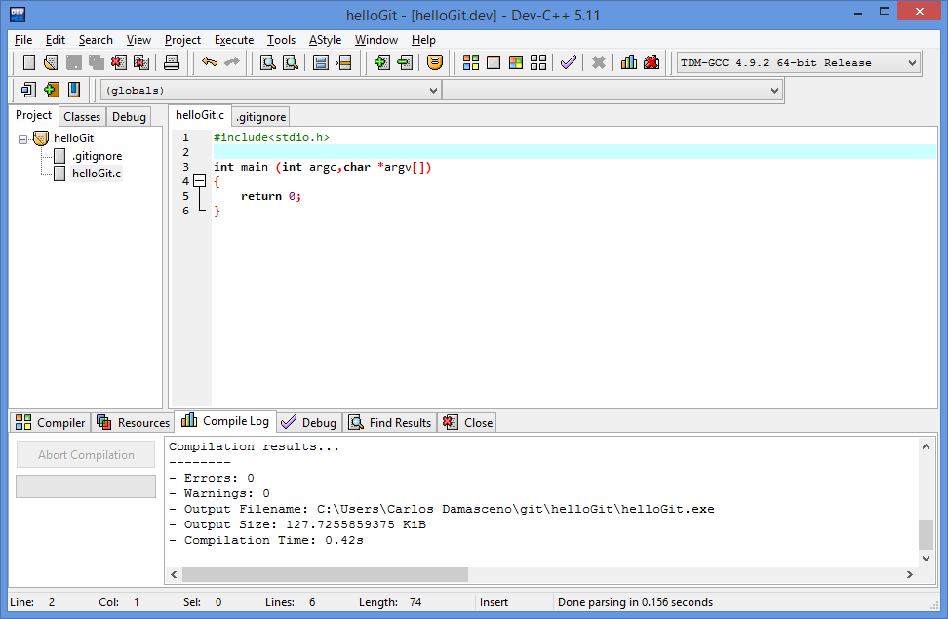
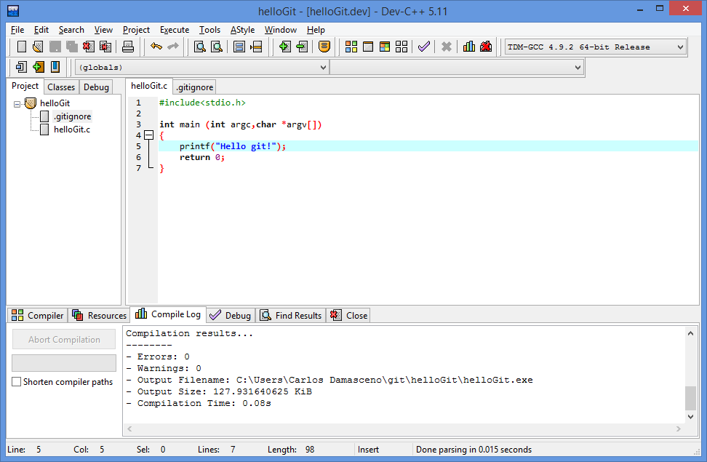
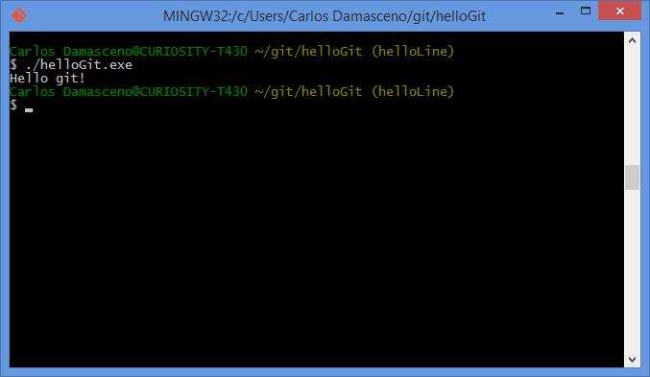
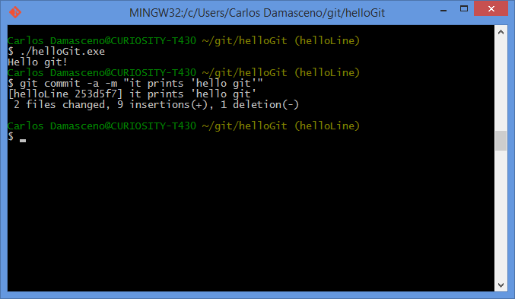
Crash Course (Getting Started)
Notes:
Let’s Edit the file! Make it say “hello git”

Slide 33
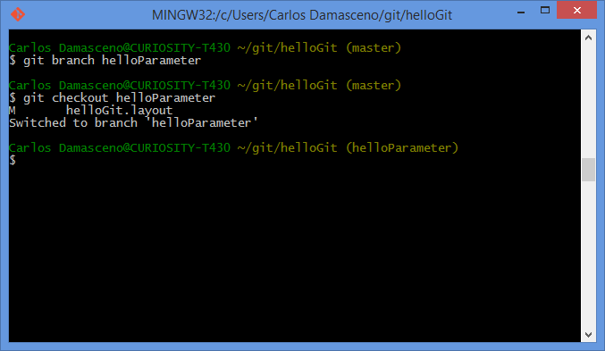
Crash Course (Getting Started)
git branch <branch name>
git branch
git checkout <branch name>
helloParameter
Notes:
git branch
The command creates a new branch head named <branch name>.
With no arguments, branches are listed; the current branch will be highlighted with an asterisk.

Slide 34
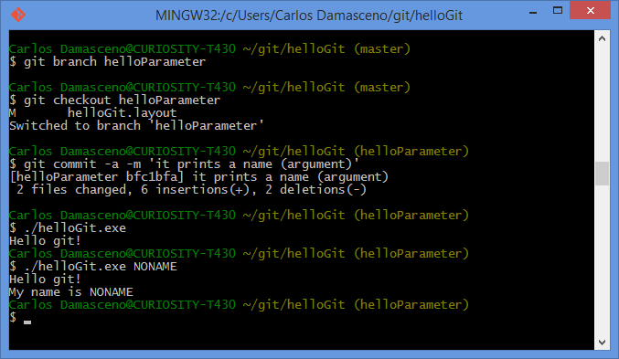
Crash Course (Getting Started)
Notes:
Let ‘s make it say your name!

Slide 35
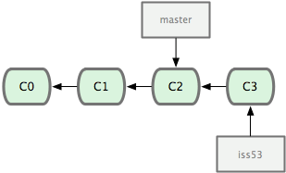
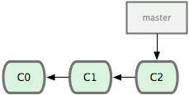
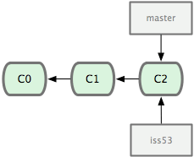
Crash Course (Getting Started)

Slide 36
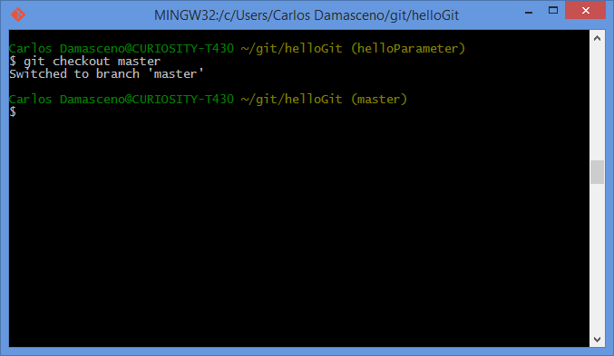
Crash Course (Getting Started)
Notes:
Let’s return to the master branch

Slide 37
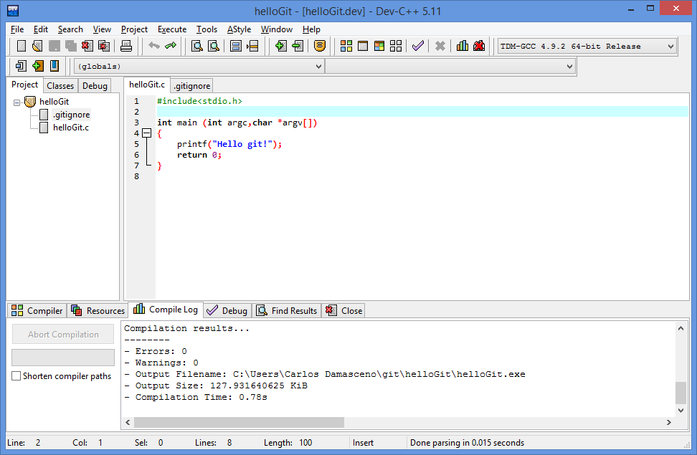
Crash Course (Getting Started)
Notes:
Let’s return to the master branch

Slide 38
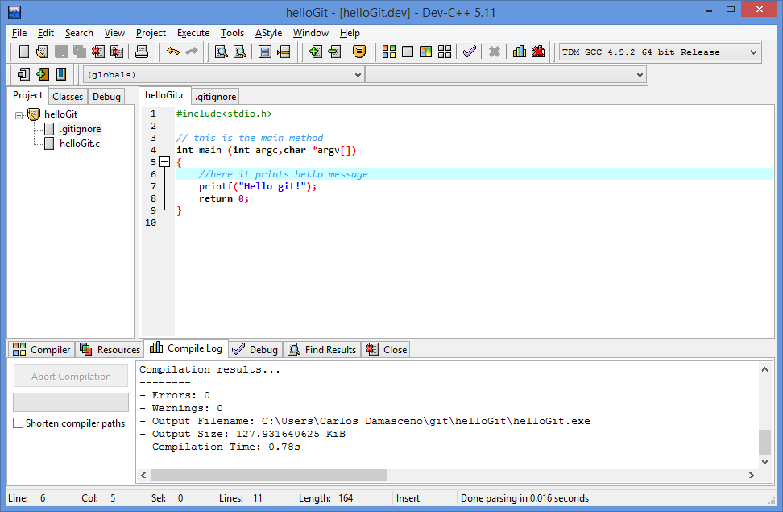
Crash Course (Getting Started)
Notes:
Let’s return to the master branch

Slide 39
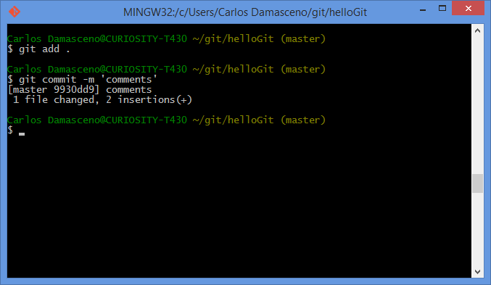
Crash Course (Getting Started)
Notes:
Let’s return to the master branch

Slide 40
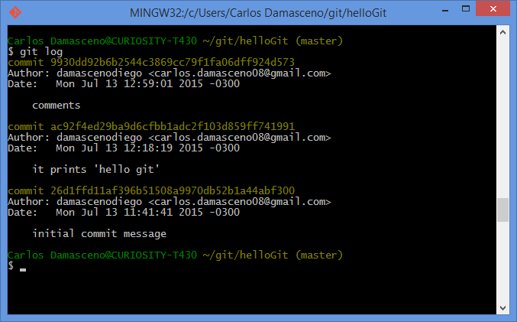

Crash Course (Getting Started)
git log

Slide 41
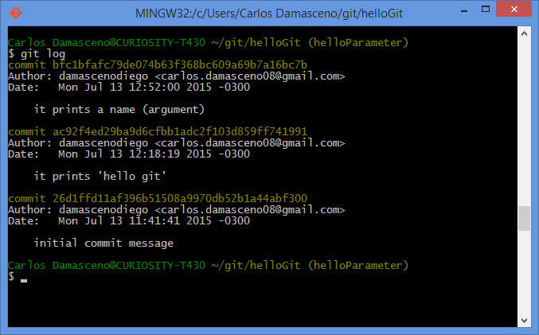
Crash Course (Getting Started)
Notes:
Let’s return to the master branch

Slide 42
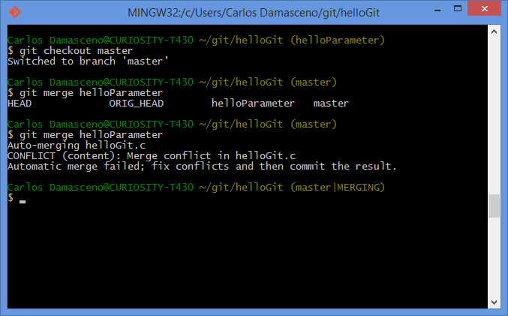
Crash Course (Getting Started)
git merge <branch name>

Slide 43

Crash Course (Getting Started)

Slide 44

Crash Course (Getting Started)

Slide 45

Crash Course (Getting Started)
git log
git log –oneline --graph

Slide 46

Crash Course (Getting Started)

Slide 47

Crash Course (Getting Started)

Slide 48

Crash Course (Getting Started)

Slide 49

Crash Course (Getting Started)

Slide 50

Crash Course (Getting Started)
git log
git log –oneline --graph

Slide 51


Crash Course (Getting Started)
git diff

Slide 52

Crash Course (Getting Started)

Slide 53

Crash Course (Getting Started)

Slide 54
Crash Course on GIT (Short Version)
GitHub 101

Slide 55



Crash Course (GitHub 101)
Github
Social coding
Open source
9.3M people collaborating
21.9M repositories
https://github.com
D3: JavaScript virtualization library for SVG and HTML
Ruby on Rails: Popular Web framework based on Ruby

Slide 56

Crash Course (GitHub 101) – Create Account
← Username
← Email
Password
Click here!
https://github.com

Slide 57

Crash Course (GitHub 101) – Create Account

Slide 58


Crash Course (GitHub 101) – Create Repository

Slide 59

Crash Course (GitHub 101) – Create Repository

Slide 60

Crash Course (GitHub 101) – Create Repository
COPY

Slide 61

Crash Course (GitHub 101) – Create Repository
git remote add <repository name> <url>
git push -u <repository name> <branch name>
https://github.com/<YOUR USERNAME>/helloGit.git
origin
master
Notes:
git remote
Manage the set of repositories ("remotes") whose branches you track.
git push
Updates remote refs using local refs, while sending objects necessary to complete the given refs.

Slide 62

Crash Course (GitHub 101) – Create Repository
COPY
Notes:
Create another directory named ”gitclone” → mkdir gitclone
Change for this directory → cd gitclone

Slide 63

Crash Course (GitHub 101) – Clone a Remote Repository
git clone <url> <target directory>
https://github.com/<YOUR USERNAME>/helloGit.git
Notes:
git clone
Clone a repository into a new directory.

Slide 64

Crash Course (GitHub 101) – Clone a Remote Repository
git tag <tagname>
Notes:
git tag

Slide 65


Crash Course (GitHub 101) – Clone a Remote Repository
Notes:
git tag

Slide 66



Crash Course (GitHub 101) – Fork Repository

Slide 67

Crash Course (GitHub 101) – Fork Repository

Slide 68

Crash Course (GitHub 101) – Fork Repository

Slide 69

Crash Course (GitHub 101) – Delete a Remote Repository

Slide 70


Crash Course (GitHub 101) – Delete a Remote Repository

Slide 71

Crash Course (GitHub 101) – Delete a Remote Repository

Slide 72
Crash Course (GitHub 101) – Other features
Readme.md
Wiki page
Web diff (code/image)
Pull Request
Comment & Discuss
Issue Tracking

Slide 73

Crash Course (GitHub 101) – Readme.md

Slide 74

Crash Course (GitHub 101) – Wiki Page

Slide 75

Crash Course (GitHub 101) – Web Diff (Code)

Slide 76

Crash Course (GitHub 101) – Web Diff (Image)

Slide 77

Crash Course (GitHub 101) – Pull Request
How can I have commits accepted in another project?

Slide 78


Crash Course (GitHub 101) – Pull Request
Notes:
It is going to be shown later on Egit session

Slide 79

Crash Course (GitHub 101) – Comment & Discuss

Slide 80

Crash Course (GitHub 101) – Issue Tracking

Slide 81
Crash Course on GIT (Short Version)
Git clients

Slide 82


Crash Course (Eclipse Git)
Eclipse Git (EGit)
Eclipse plug-in
Allows you to use Git directly within Eclipse IDE
Perspective and Views
Based on the JGit library.
Java library implementing Git functionalities
http://wiki.eclipse.org/EGit/User_Guide

Slide 83

Crash Course (Netbeans)
Git Support in Netbeans IDE
NetBeans IDE
Supports for Git version control client
https://netbeans.org/kb/docs/ide/git.html

Slide 84

Crash Course (Visual Studio)
Visual Studio Tools for Git
Team Explorer Extension
https://visualstudiogallery.msdn.microsoft.com/abafc7d6-dcaa-40f4-8a5e-d6724bdb980c

Slide 85
References++
Books
Eric Sink. 2011. Version Control by Example (1st ed.). PYOW Sports Marketing. (FREE EBOOK)
Scott Chacon and Ben Straub. 2014. Pro Git (2nd ed.). Apress, Berkely, CA, USA. (FREE EBOOK)
Pressman, R. S. Software engineering: A practitioner’s approach. 5th ed. McGraw-Hill Higher Education, 2001.
Kemper C., Oxley, I. 2012. Foundation Version Control for Web Developers. Appress.
Videos/Courses
Learn Git in 20 Minutes: https://www.youtube.com/watch?v=Y9XZQO1n_7c
The Basics of Git and GitHub: https://www.youtube.com/watch?v=U8GBXvdmHT4
How to Use Git and GitHub: https://www.udacity.com/course/how-to-use-git-and-github--ud775
Web pages
https://confluence.atlassian.com/display/BITBUCKET/Bitbucket+101
https://sourceforge.net/p/forge/documentation/Git/
https://training.github.com/
https://www.atlassian.com/git/tutorials/
http://www.vogella.com/tutorials/EclipseGit/article.html
Notes:
HERE ARE SOME OTHR REFERENCES YOU CAN LOOK LATER

Slide 86


THANK YOU!
http://goo.gl/forms/y7lZNFXOE6

Slide 87
Crash Course on GIT (Short Version)
Carlos Diego N. Damasceno - https://github.com/damascenodiego/

